Slide 1

Mobile App Store ( 7200 apps)
Data Analysis
Group Number : 42
Group Member: Xinyu Hu , Linjie Zhou

Slide 2
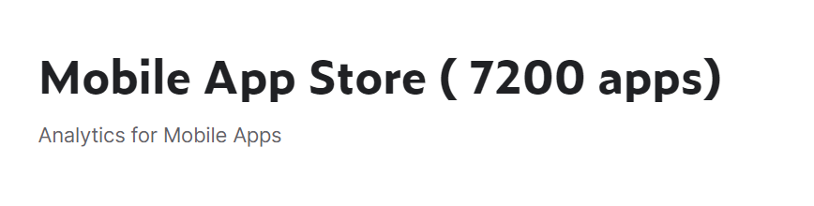
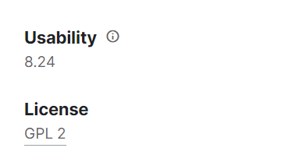
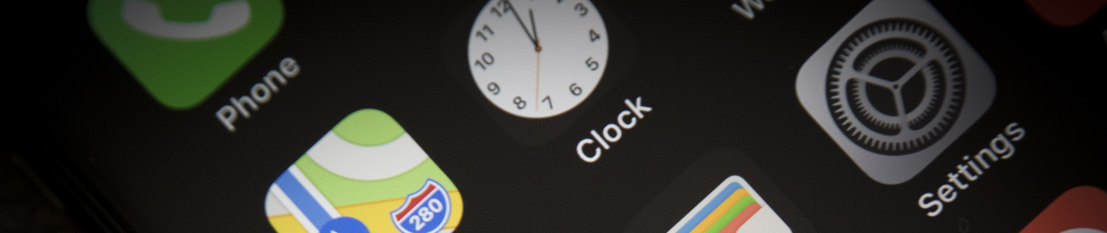
the Dataset we choose:

Slide 3
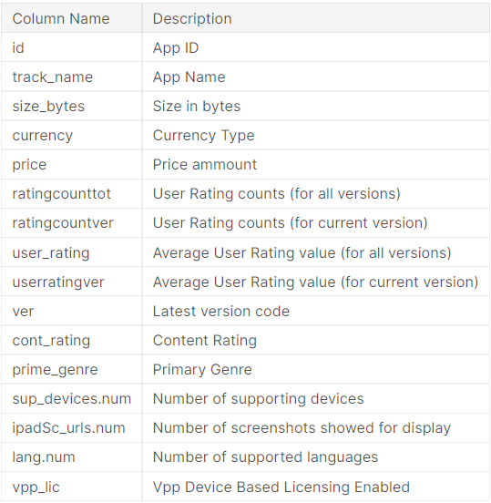
Background and significance of database seletion
Data description
Mobile App Statistics (Apple iOS app store):
The ever-changing mobile landscape is a challenging space to navigate.
The percentage of mobile over desktop is only increasing. Mobile app analytics is a great way to understand the existing strategy to drive growth and retention of future user.
About Dataset
This data set contains more than 7200 Apple iOS mobile application details. The data was extracted from the iTunes Search API at the Apple Inc website.

Slide 4
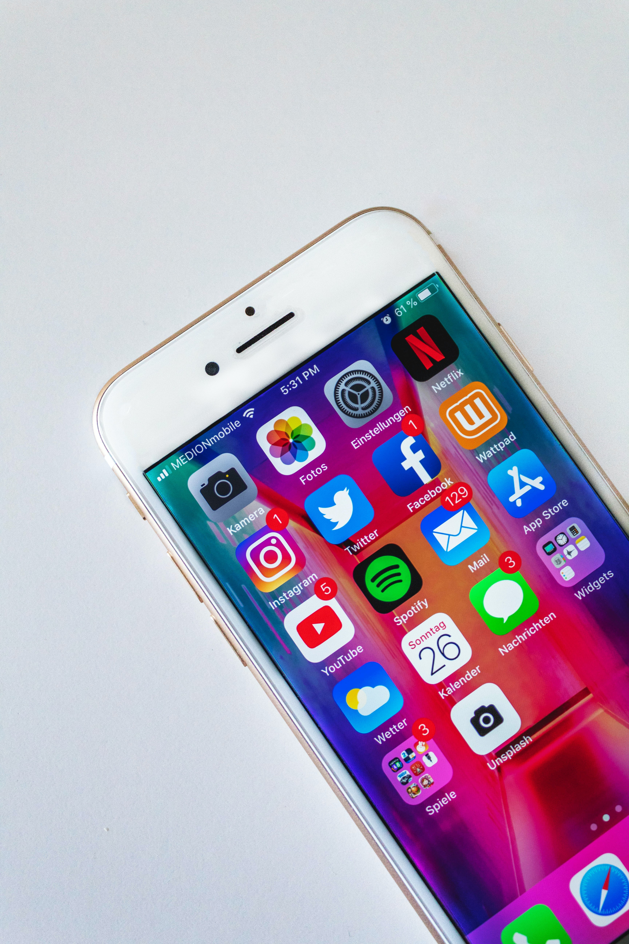
We try to analyze and answer following questions:
How do you visualize price distribution of paid apps ?
How does the price distribution get affected by category ?
What about paid apps Vs Free apps rating?
Which category has the most highgest rating in paid&free apps?
Does mean user rating depend on the category?
Are paid apps good enough ?
What about the total number of user rating?
Does current version generally have more rating than total overall rating?

Slide 5
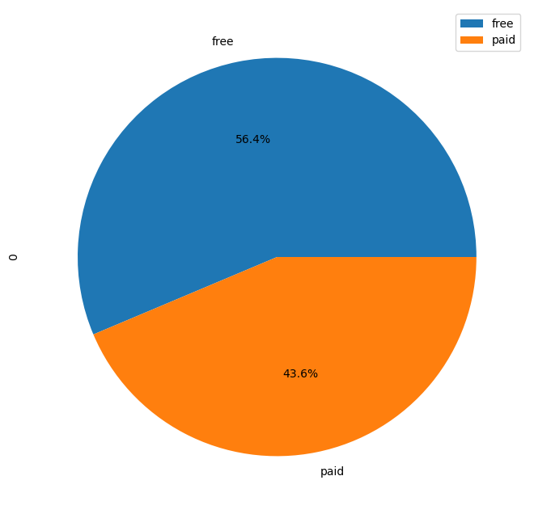
Let's visualize the percentage of paid and free apps.

Slide 6
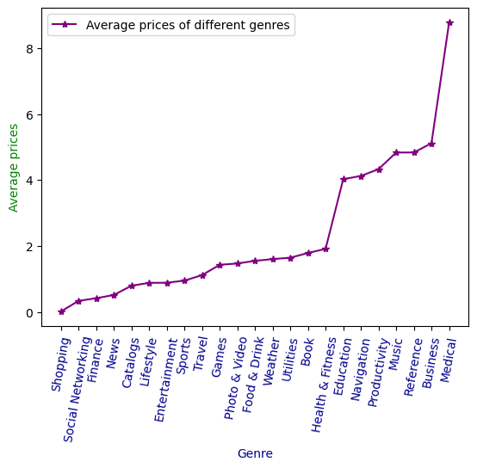
How does the price distribution get affected by category ?
Illustrate:
Medical is the most expensive genre.
Shopping is the cheapest genre.
Guess:
This difference may be due to the development cost and operating profit return of the app.
Make sense because they provide services and users already pay to use the service.

Slide 7
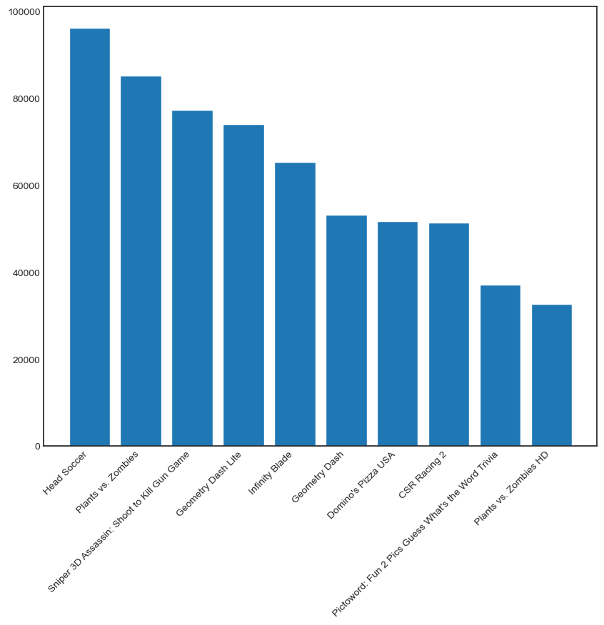
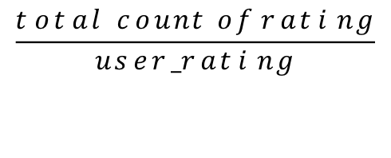
Let's visualize top 10 higher rating applications in bar plot
$$\frac{total count of rating}{user_rating}$$
We use
to weigh the popularity of each apps
Head Soccer
is the most popular app

Slide 8
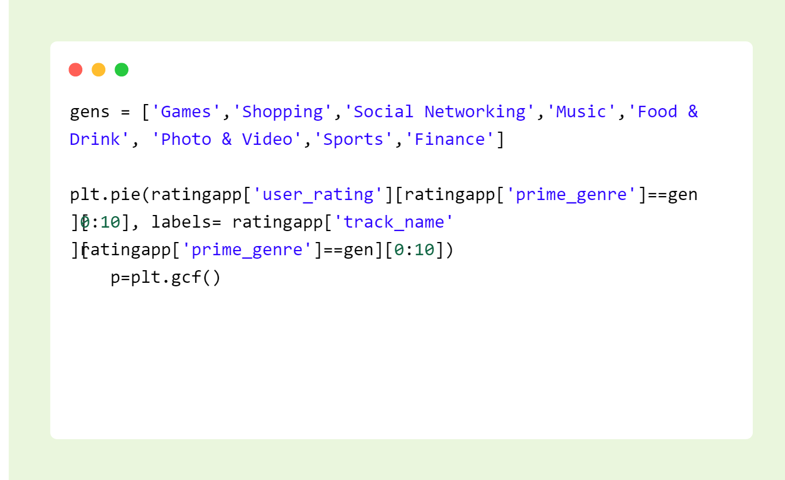
We divide the Apps by categories.
Take a look at the top10 Apps in each category.

Slide 9
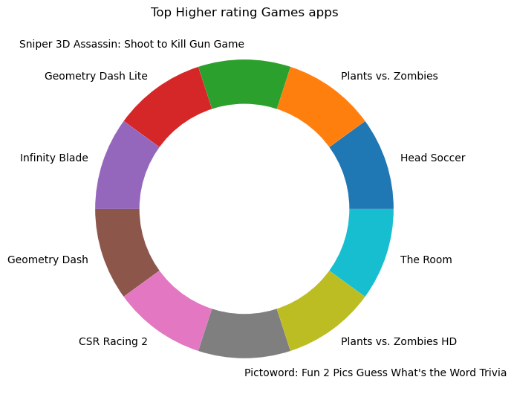
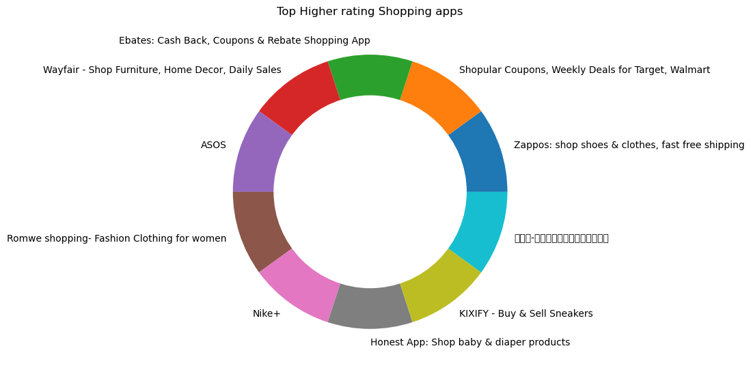
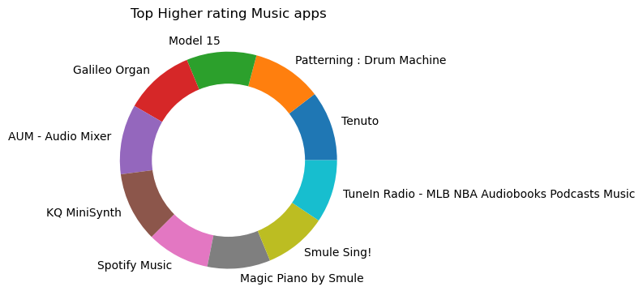
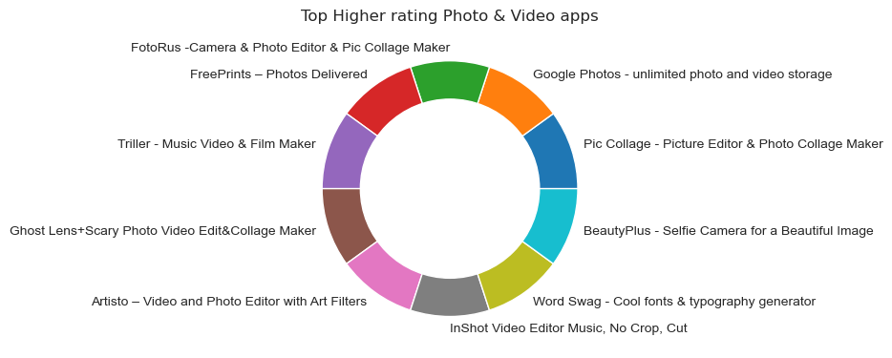

Slide 10
Analyze the ratings of paid and free
apps

Slide 11
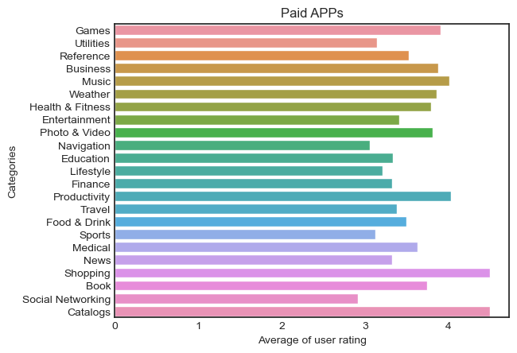
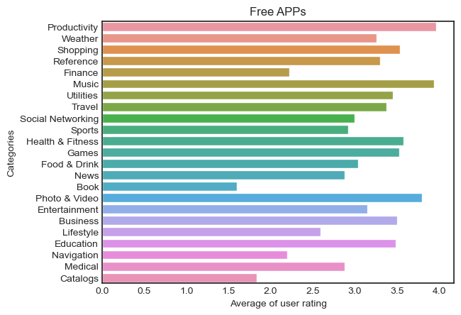
Which category has the most highgest rating?
Does mean user rating depend on the category?
We can see：Shopping & Catalogs are the two highest rated categories of paid Apps. Productivity & Music are the two highest rated categories of free Apps.

Slide 12
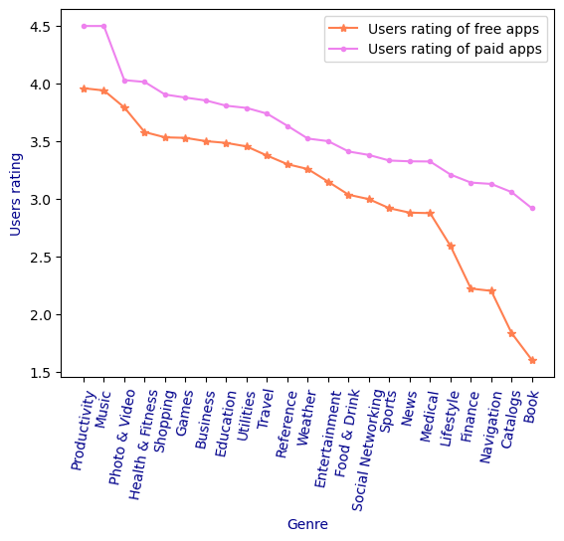
Are paid apps better than free apps?
Let's visualize the average rating of paid and free apps in each genre.
Illustrate:
For any genres of apps, users rating of free apps is higher than paid apps.
Specially:
The trend of high and low ratings of different genres is the same.
eg: the Productivity is the highest rating type in both paid and free apps.
Books in paid apps have high mean rating, however very less in free apps. The same in Catalogs.

Slide 13
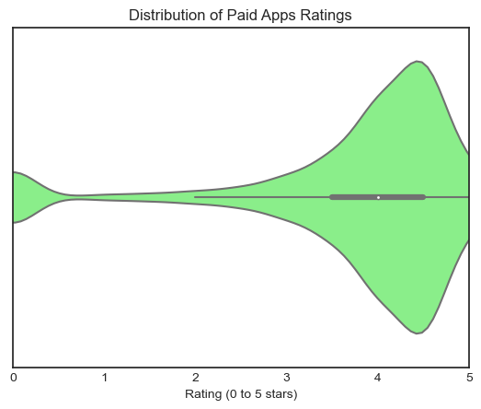
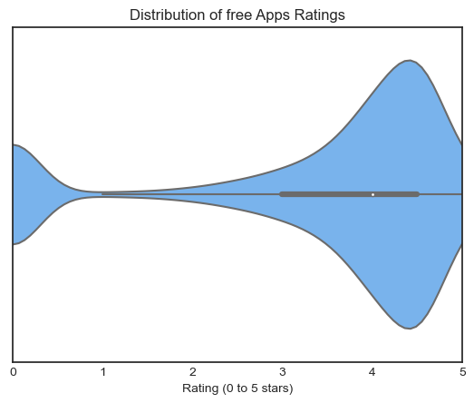
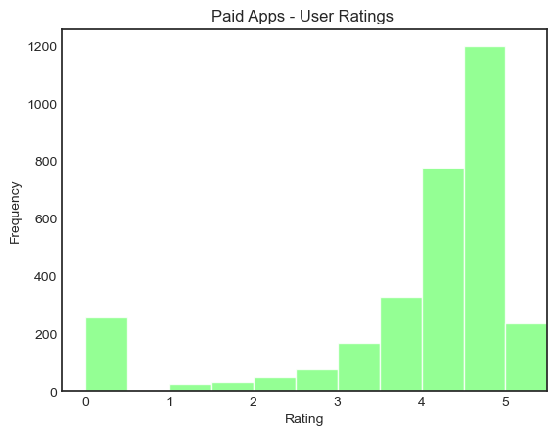
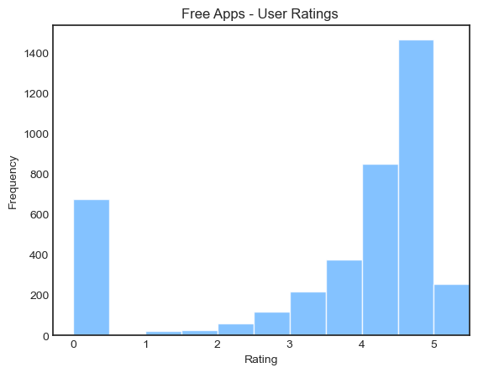
Let's take a look at the rating distribution generally.

Slide 14
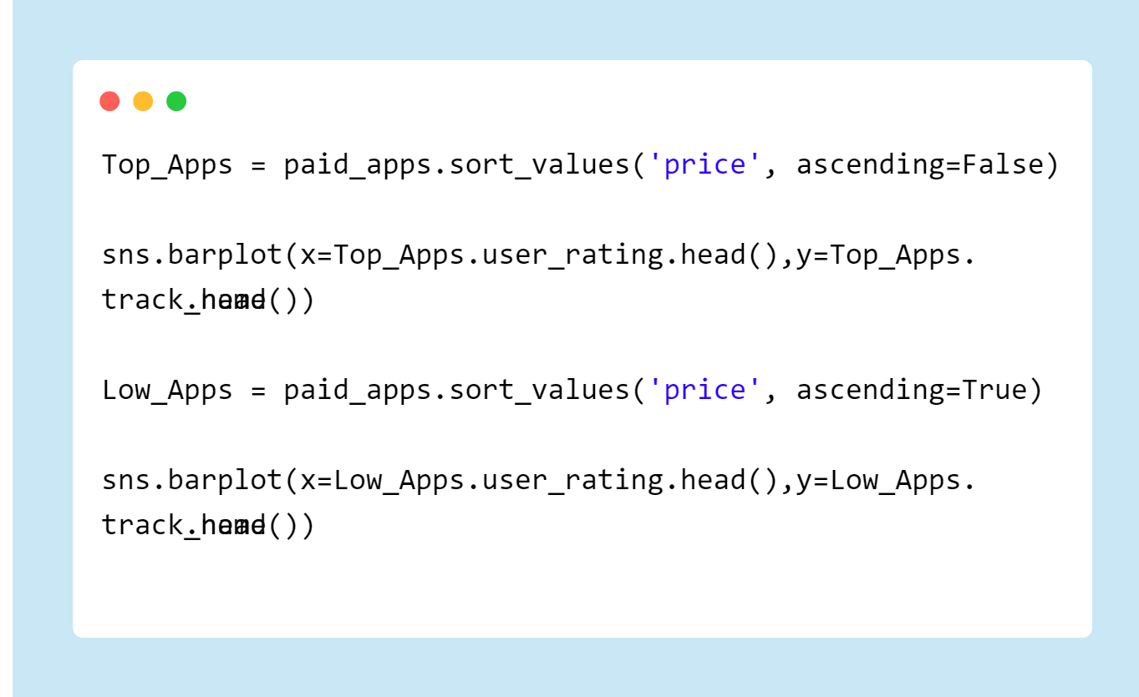
Are they in this distribution regardless of whether the prices are high or low?
We take a look directly at the ratings of the most expensive and the lowest priced Apps.

Slide 15
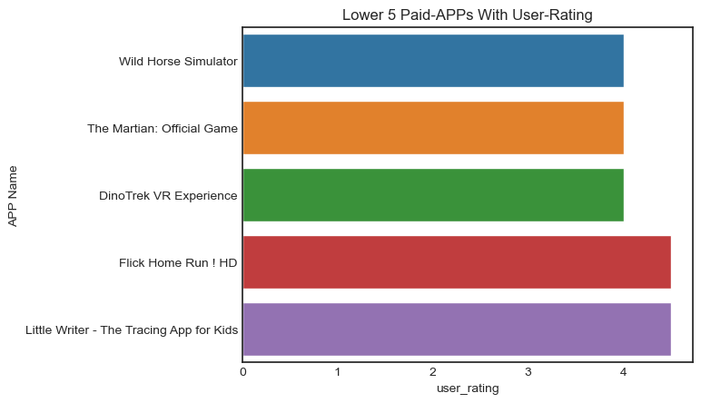
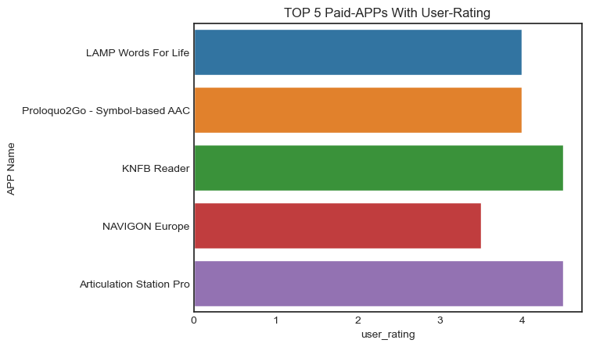
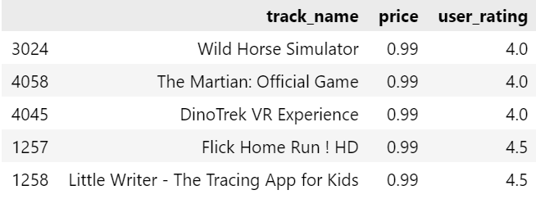
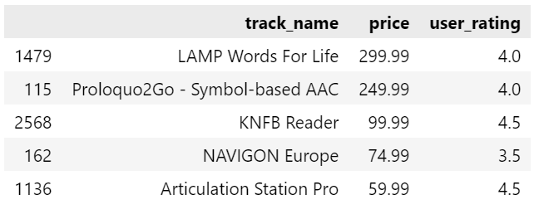

Slide 16
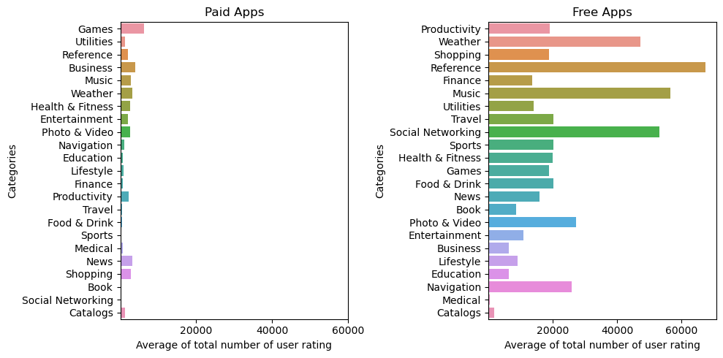
What about the total number of user rating?

Slide 17
What about the total number of user rating?
Illustrate:
Users are less inclined to give feedback or rating to paid apps. However they do in free apps!
Side reflection:
Free apps reach a much larger audience.
Users are more likely to use free apps.
(since the average ratings between them are same!)

Slide 18
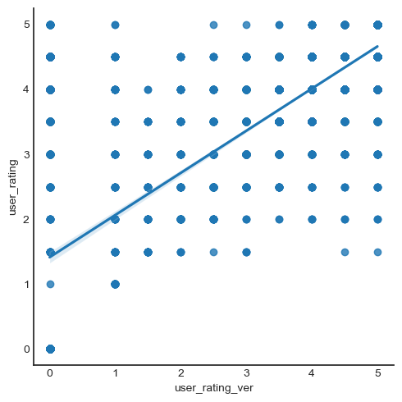
Does current version generally have more rating than total overall rating?
We draw a scatter plot and linear regression line using user_rating_ver & iser_rating.
There is a strong positive correlation between two variables.
This explains why software developers need to constantly update their software to improve its quality and performance to gain user acceptance.

Slide 19

Requirements:
streamlit
pandas
matplotlib
seaborn
numpy

Slide 20
THANKS
THANKS

